Slide 1
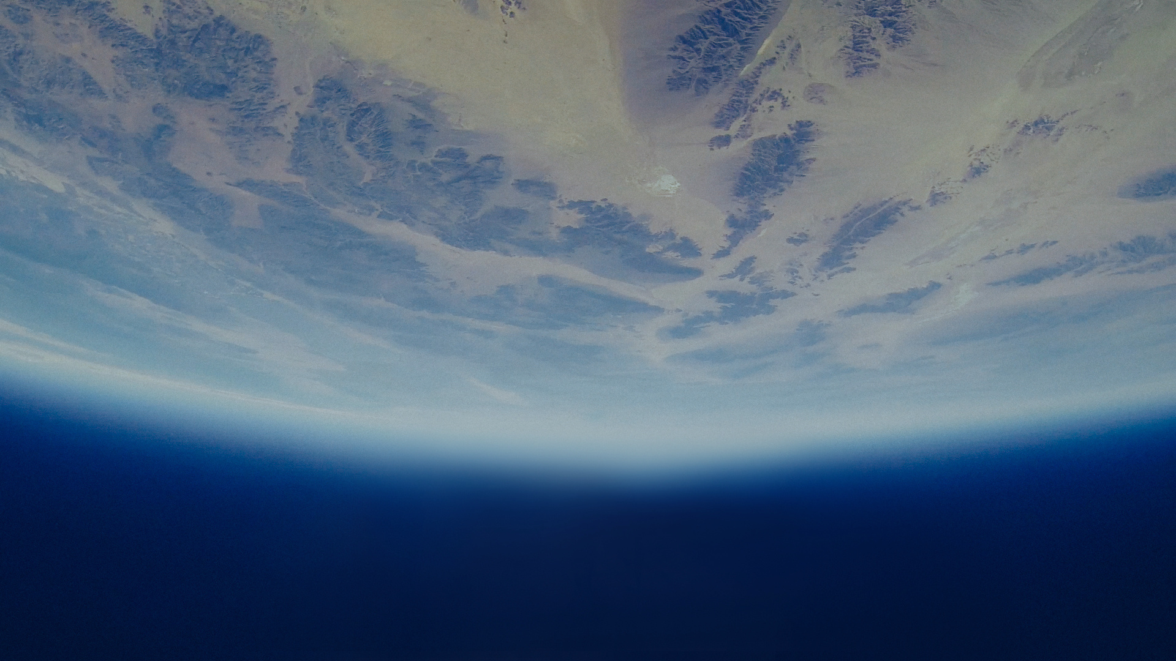
NSAC 2025
HELIO
MESH

Slide 2

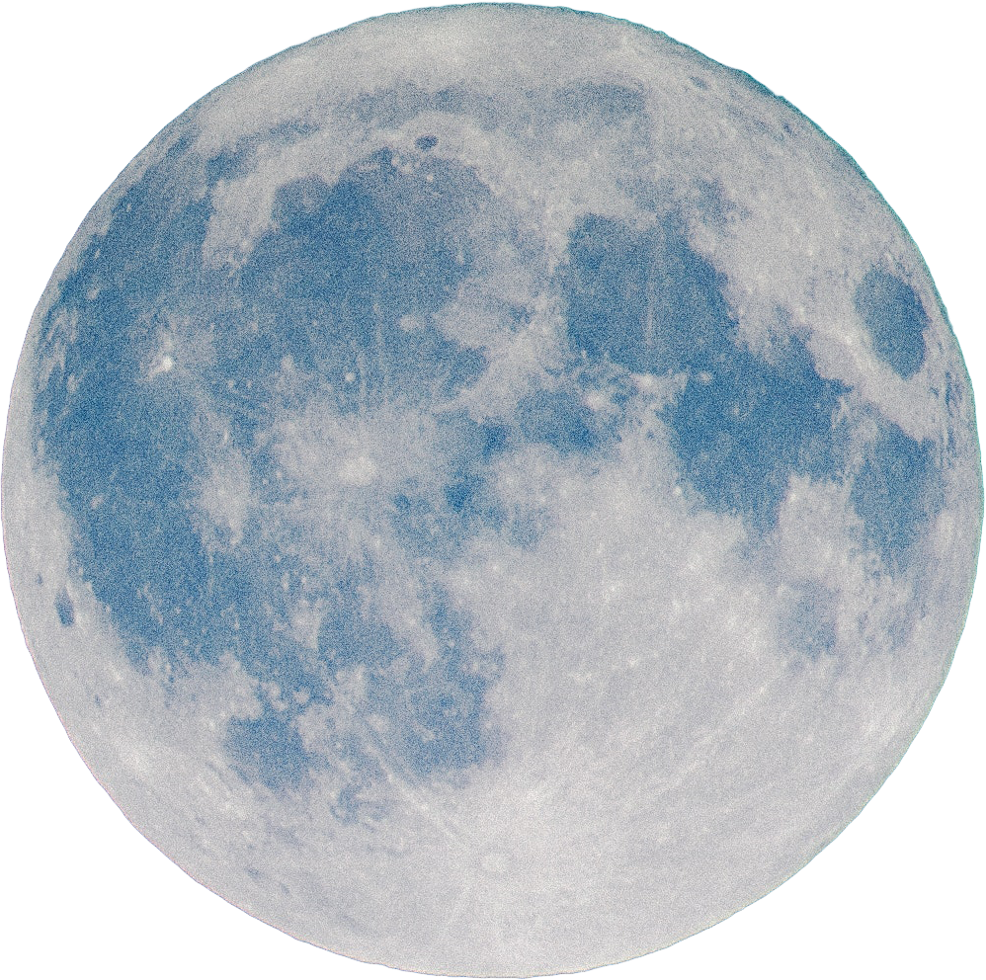
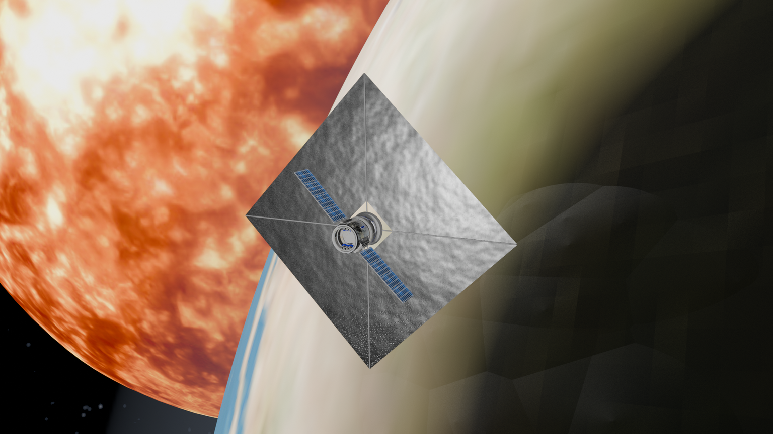
NSAC 2025
Helio Mesh
HYBRID SATELLITE ENERGY SYSTEM
HelioMesh is a hybrid energy solution for satellites that combines solar wind kinetic energy
and traditional solar panel power.
Using reinforcement learning to predict space weather, the system automatically switches
between power collection and propulsion modes.
This guarantees continuous performance and extended mission lifetime even under
unstable conditions.

Slide 3

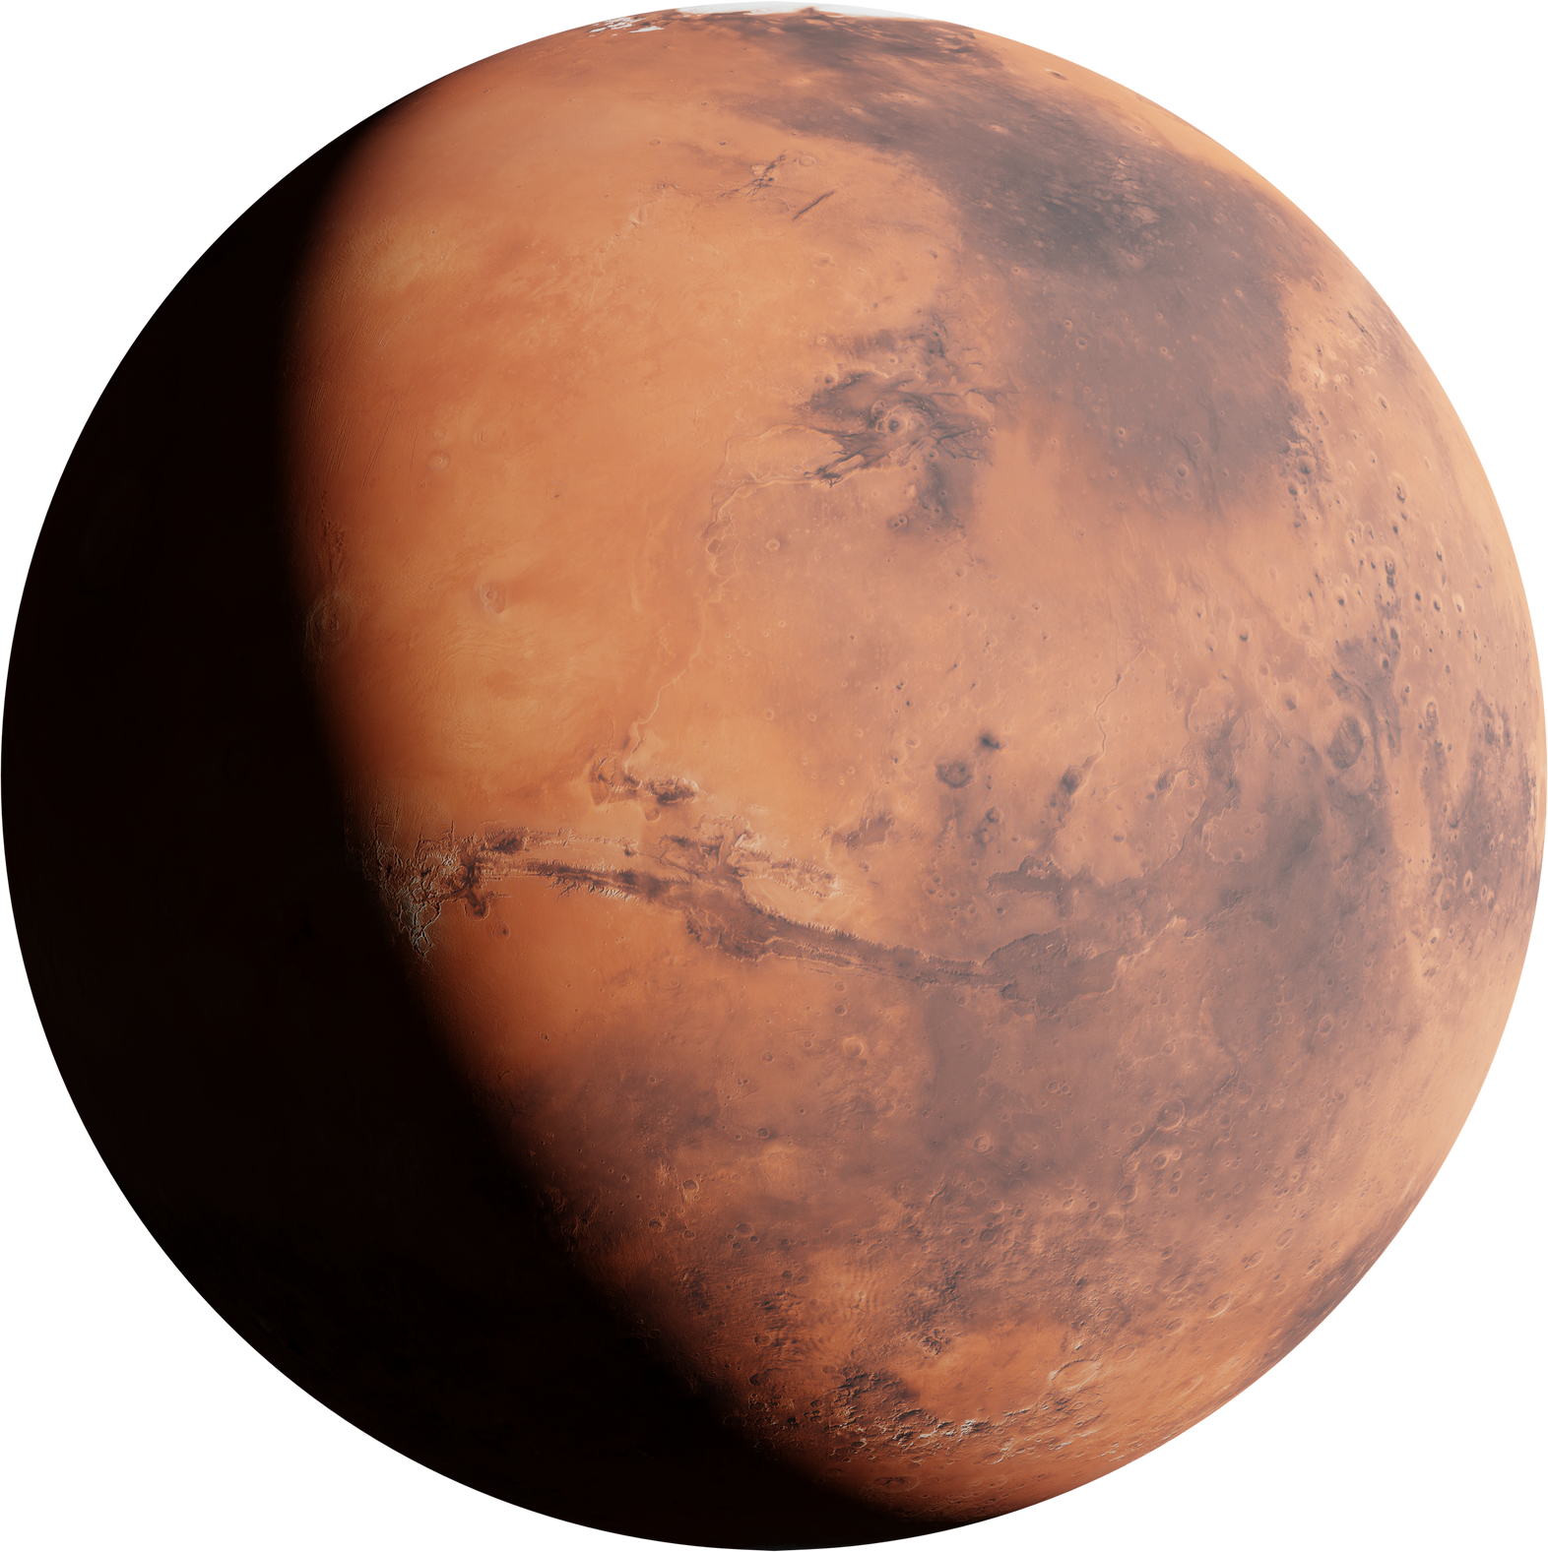
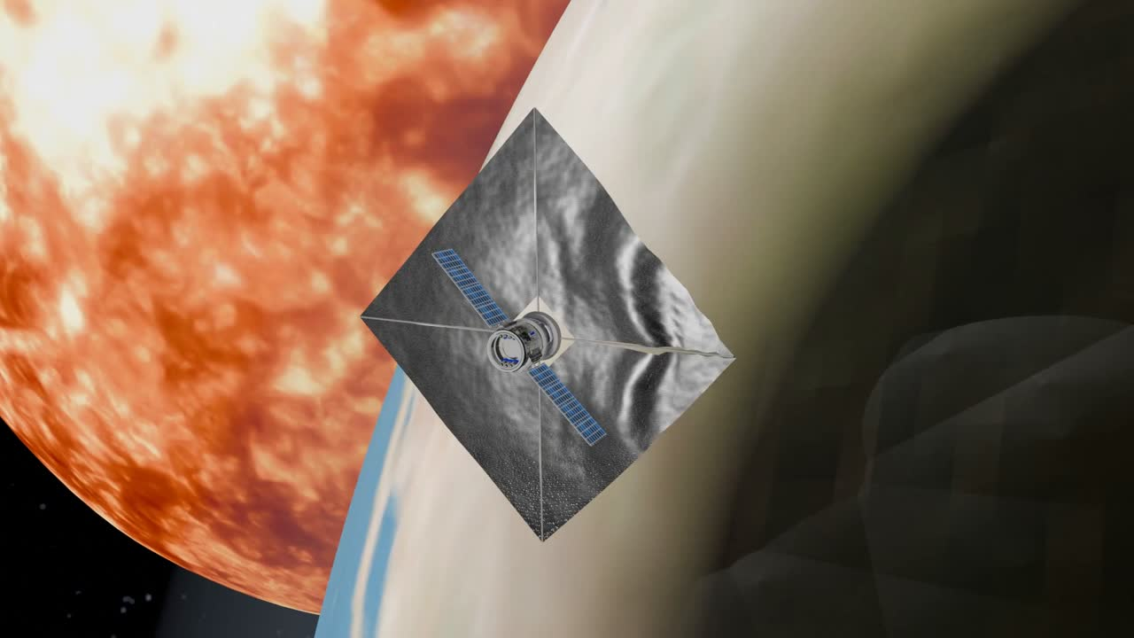
NSAC 2025
Helio Mesh
OUR PROTOTYPE
Our modular solar sail system dynamically adjusts its thin sails by extending or retracting supporting poles, controlled by a Reinforcement Learning (RL) algorithm.
The RL controller uses real-time spacecraft data like solar radiation and sail tension to optimize thrust and ensure structural safety, learning through rewards and penalties.
By using NASA’s dataset such as OMNI 2, which provides historical space weather data on solar wind and magnetic fields, the system predicts future conditions, like solar storms, enabling proactive adjustments for safer, more efficient missions.
Ideally this system could be implement in most satellites already in orbit by structuring it in smaller modules

Slide 4
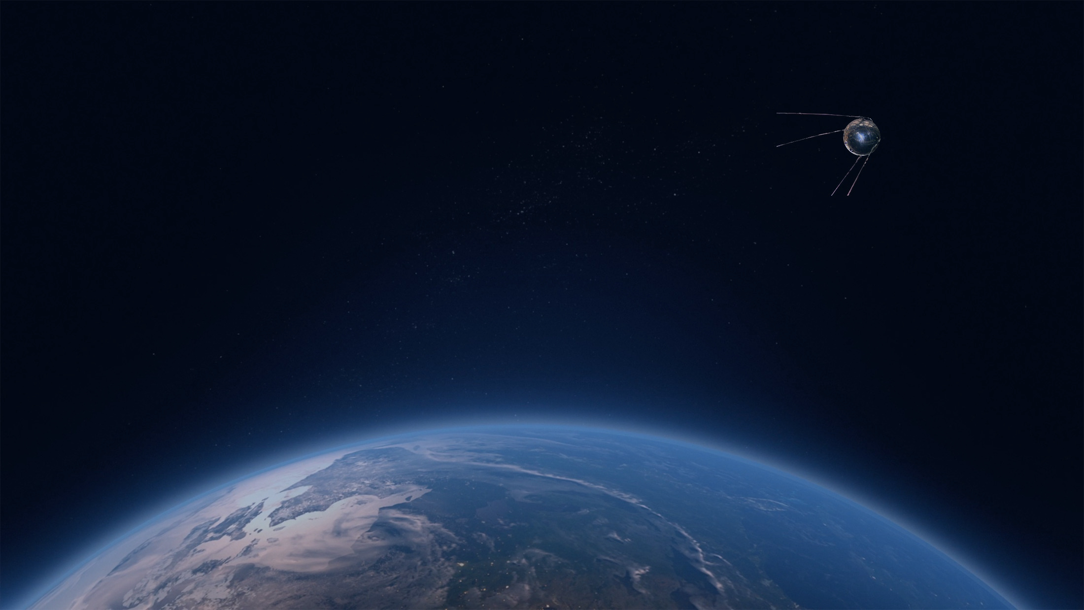
NSAC 2025
Helio Mash
BENEFITS
Solar sails offer a revolutionary approach to space propulsion by using sunlight to drive spacecraft forward.
This technology harnesses the momentum of photons, the particles of light, which strike the sail’s reflective surface and transfer a small amount of force, generating continuous thrust without the need for traditional fuel.
Their fuel-free design extends satellite lifespans, reduces space debris and lowers both launch costs and CO₂ emissions by minimizing heavy fuel and battery systems.
Utilizing clean solar energy, solar sails enable autonomous operations and provide backup power for critical satellite functions, paving the way for cost-effective and eco-friendly missions to explore the cosmos.

Slide 5

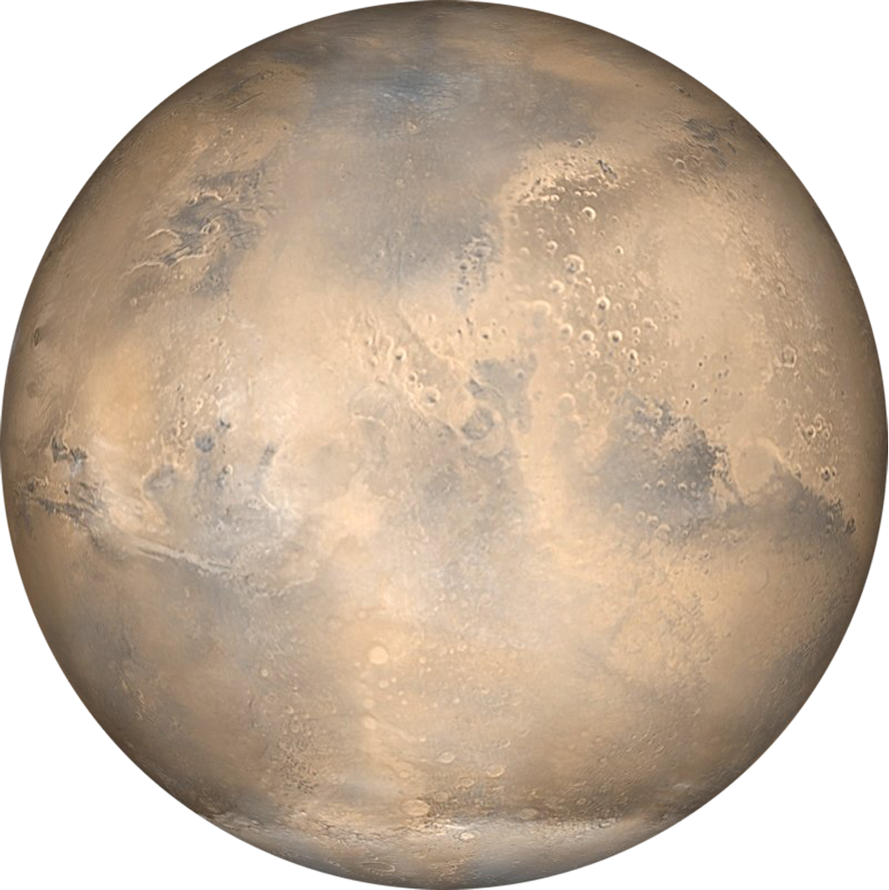
NSAC 2025
Helio Mash
POTENTIAL RISKS
1
Orbital Crowding: The widespread adoption of solar sails could increase collision risks if not properly coordinated.
2
Light Reflection Toward Earth: Large reflective surfaces might cause minor optical disturbances, but can be mitigated through controlled orientation.
3
Minimal Space Environment Interaction: Solar sails interact with solar plasma and magnetic fields, but the effect is negligible for near-Earth orbits.

Slide 6

NSAC 2025
Helio Mash
OUR ADVANCEMENTS
Our Software: SaaS AI Platform
Cloud-based algorithms ingest real-time IMF, solar wind, and plasma data.
Dynamically optimizes sail orientation and energy allocation.
Turns space weather volatility into operational advantage.
1
2
Our Strategic Advantages
Fuel-less orbital adjustments → lower costs, longer mission life.
Adaptive energy harvesting → dynamic balance of thrust vs. power generation.
Scalable & modular → from single satellites to constellations.
Data-driven optimization → leverages OMNIWeb and DSCOVR datasets in near real-time.
3
Pilot Partnerships – Collaborate with CubeSat/smallsat operators to demonstrate in-orbit performance.
SaaS Subscriptions – Continuous optimization via HelioMesh Control Cloud.
Licensing & Hardware Sales – License AI algorithms or sell modular sails post-validation.

Slide 7

NSAC 2025
THANK YOU
Helio Mesh

